Slide 1
Risk Factor Analysis
Vaibhav Shrivastava
Big Data

Slide 2
Problem Statement & Objectives
Problem Statement: In the United States, one of the leading causes of injury and death are accidents caused by large trucks. These accidents are caused by various factors such as distance driven, speed, location, and time of day. It is important, especially for a trucking company, to analyze this risk and address it effectively.
Objective: Determine the drivers with the highest risk factor based on geographic location in order to meet the organizational goal of better understanding risk and ensure controls are in place to minimize it.

Slide 3
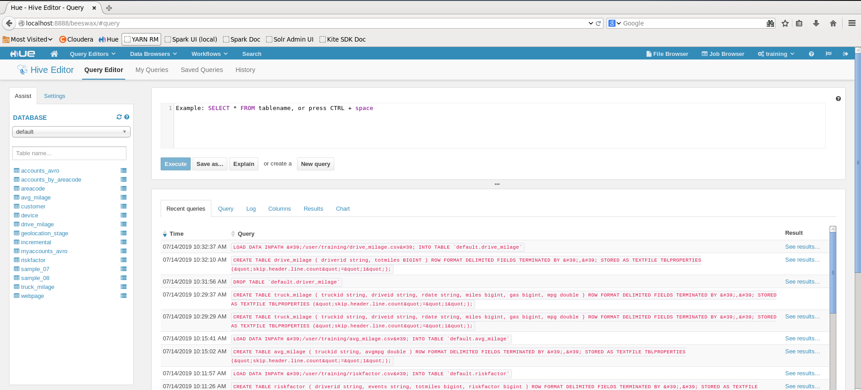
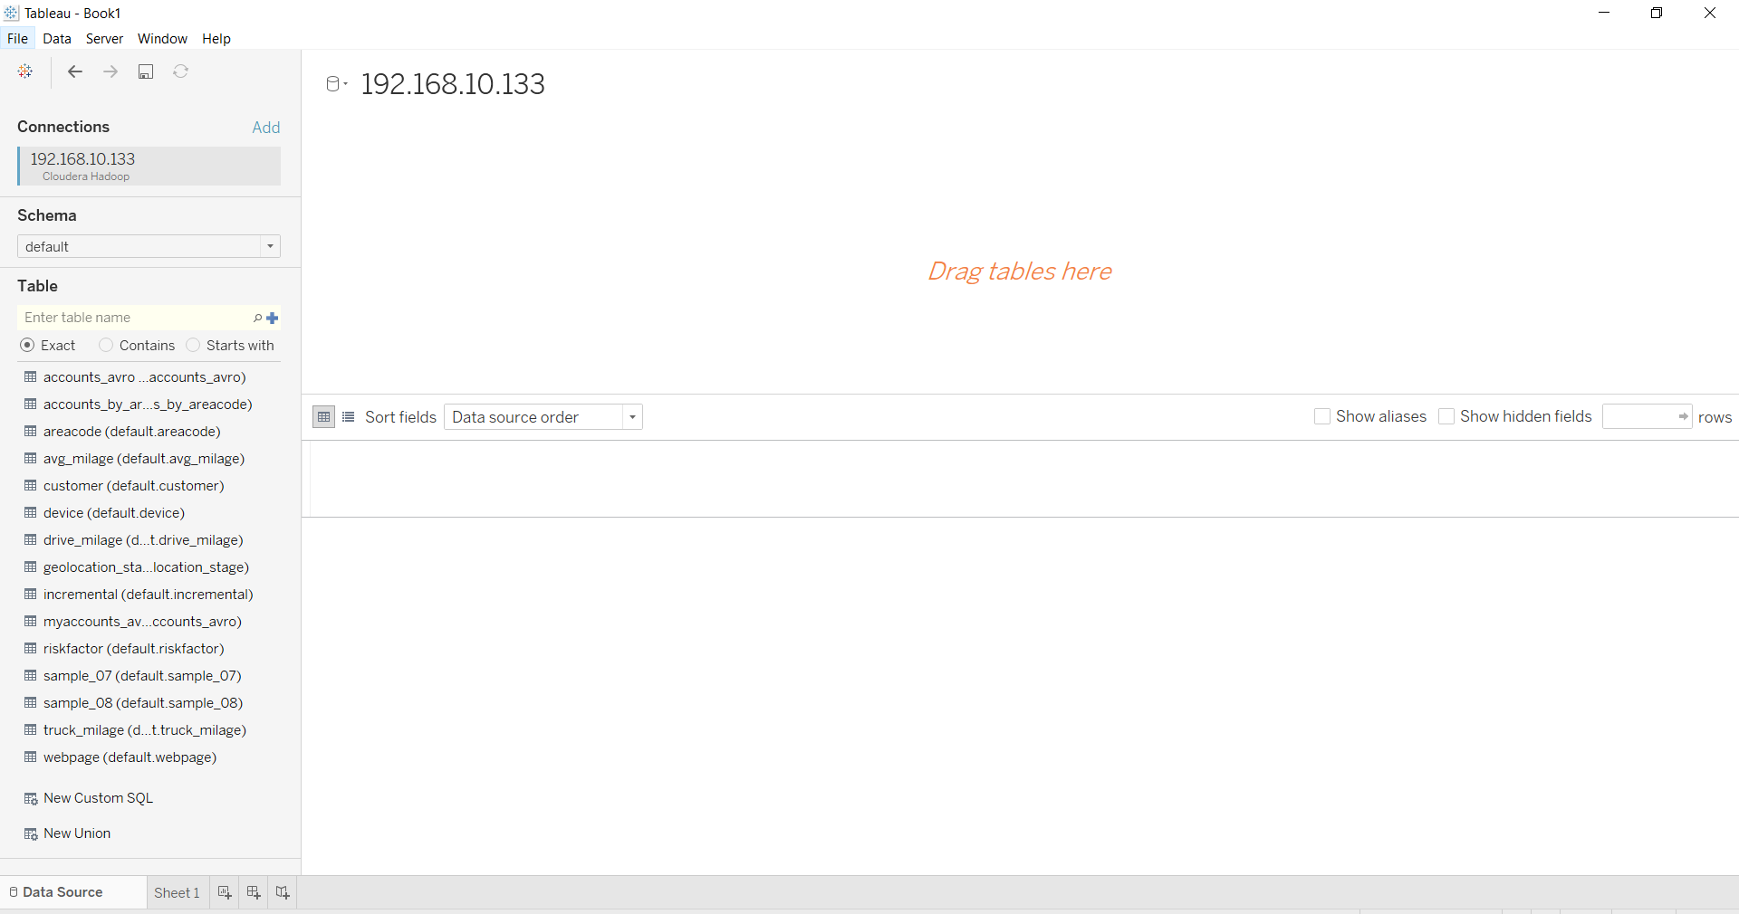
Process Flow
Trucks
Truck_mileage
01
Split each tab in original geolocation file into separate CSV files
Geolocation
Riskfactor
Drive_mileage
Avg_mileage
Image 1
02
Create Hive tables
Populate the data in each CSV file created in the previous step into 6 Hive tables (image 1)
03
Install drivers
Install JDBC and ODBC drivers to connect Hive tables to Tableau to create dashboard views
Image 2
04
Calculate Risk Factor
Use (Events/Totmiles)*1,000,000 to calculate Risk Factor and convert to a scale of 1-20 by multiplying each score by 20
04
Choose Threshold
Top 15% of drivers with highest Risk Factor score will be labeled risky

Slide 4
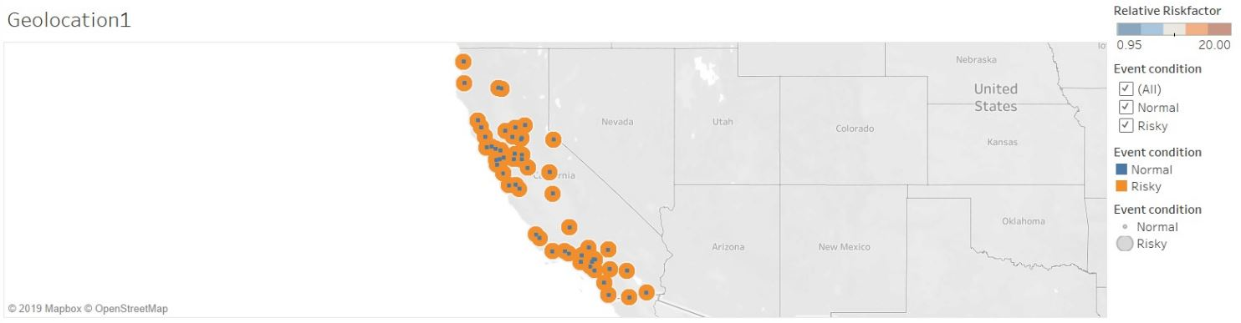
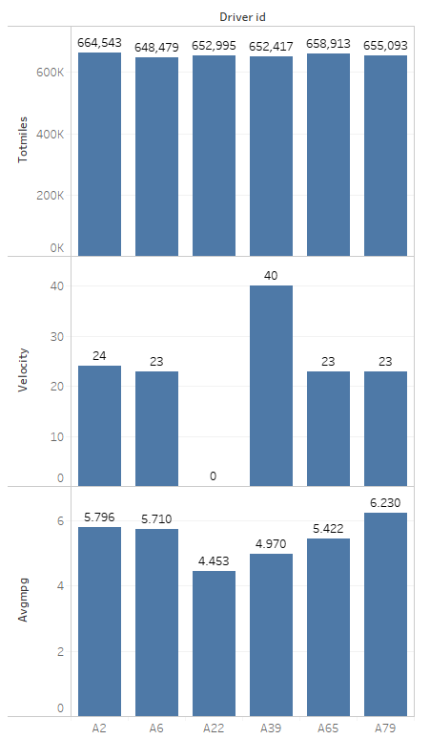
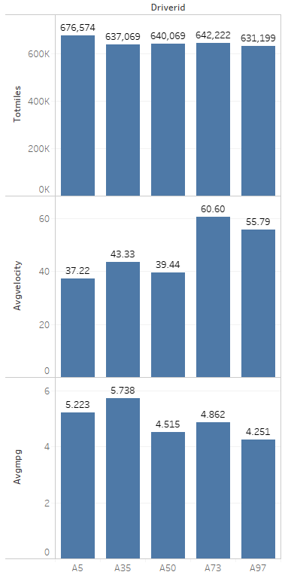
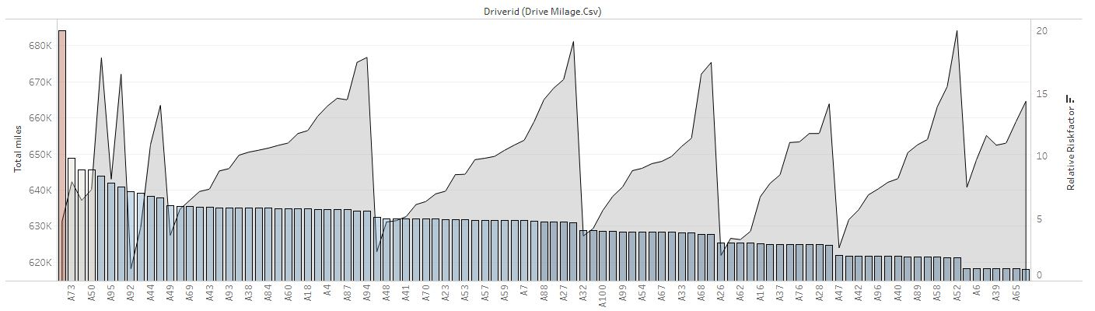
Best 6 Drivers
Worst 5 Drivers
Geolocations show where the riskiest drivers are headed.
Interesting observations:
The worst drivers had higher velocities on average than the best drivers.
But there don’t seem to be significant differences between total miles and avg mpg
Driver A97 is the worst driver. Any driver with a risk factor of 5.91 or greater has exceeded the threshold and an alert will be triggered for these drivers to corporate management and insurance.

